Slide 1


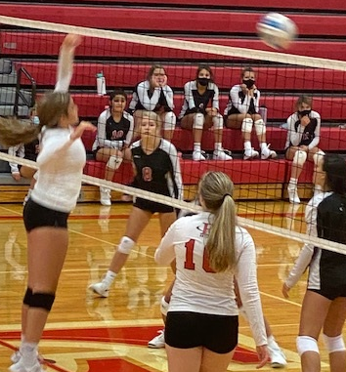
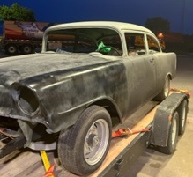

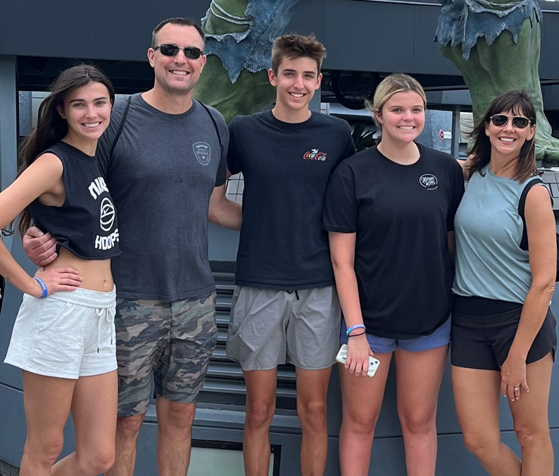

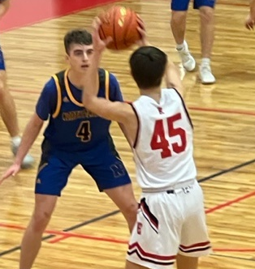
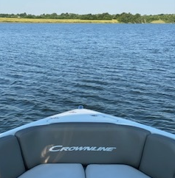




Todd Roberts F.O.R.M.
Family
Married on April Fool’s Day in 2000. My wife Paige and I lived and dated in Dallas for 5 years before that.
3 kids: Sydney (20), Nate (16), and Abby (16)
One dog – Drake (Black Lab / Great Dane mix)
My parents live nearby here in Omaha along with my brother and his wife. My wife’s family is spread out living in FL, DC, and WA.
Occupation
Senior Technical Leader. Spent the bulk of my career in telecom and cable.
My passion is building high performing teams with a focus on delivering quality software
B.S. in Telecommunications Management from The University of NE at Kearney
Fun fact: I am in my 3rd role since joining Schwab.
Recreation
I spend a lot of free time at kids sporting events. Abby plays volleyball and Nate plays basketball and runs track.
In 2022, I completed in my first sprint length triathlon.
I am working with my son to restore a 1956 Chevy 210.
We have a boat. Going to the lake is one of the few things we can get everyone in the family to agree on.
Enjoy watching sports. Husker, Creighton, Cowboys, and Mavericks fan.
Motivation
I’m motivated to provide a quality life for me and my family.
I use goals to help me stay focused and on track. I’ve set financial goals, workout goals, and other mid range and long term goals to hold myself accountable.
I am generally a happy positive person. Sometimes it’s ok just to roll out of bed and see where the day takes you.

Slide 2
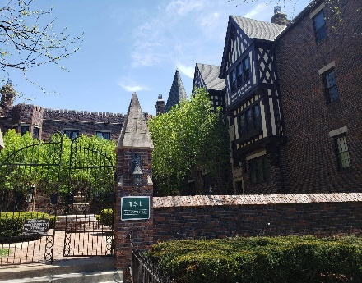
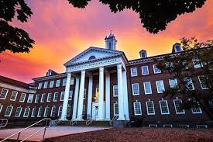
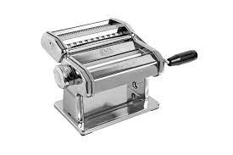


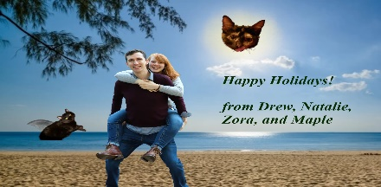
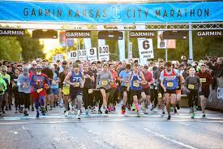

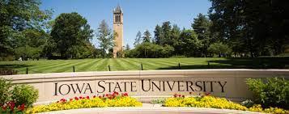
Andrew Mullinnix F.O.R.M.
Family
Have been with my partner Natalie for 4 years, and we share a charming condo with our cats that we bought at the beginning of covid.
Two Cats – Maple (2 years old) and Zora (12 years).
My immediate families live primarily in the Iowa City/Cedar Rapids corridor, and we will drive out to see them 5-6 times a year.
Occupation
Senior Developer, have been in Order Management Solutions for the last 5 years.
B.S. in Computer Engineering from Iowa State University.
In final semester of M.S. in Computer Science at the University of Nebraska at Omaha
Fun fact: I joined TDA in the ETP as the first year of the technology track.
Recreation
I enjoy participating in races with my partner. Our last being the KC half-marathon in October 2022.
I picked up the golf bug once moving out to Omaha and play in a couple leagues with members of the larger ngOMS team.
Old home restoration has become an increasing part of my life and interests, with desire for a larger restoration project.
Cooking, being food motivated, I've enjoyed learning finer skills from Natalie. We received a pasta roller for Christmas we've already begun to utilize.
Motivation
I’m motivated by longer term personal goals, whether that be race, golf, or home restoration.
From a work perspective, I'm motivated by providing the most benefit to my immediate organization and recognition of these efforts.
I value having a good working relationship with my team members.
I'm demotivated by stagnation.

Slide 3
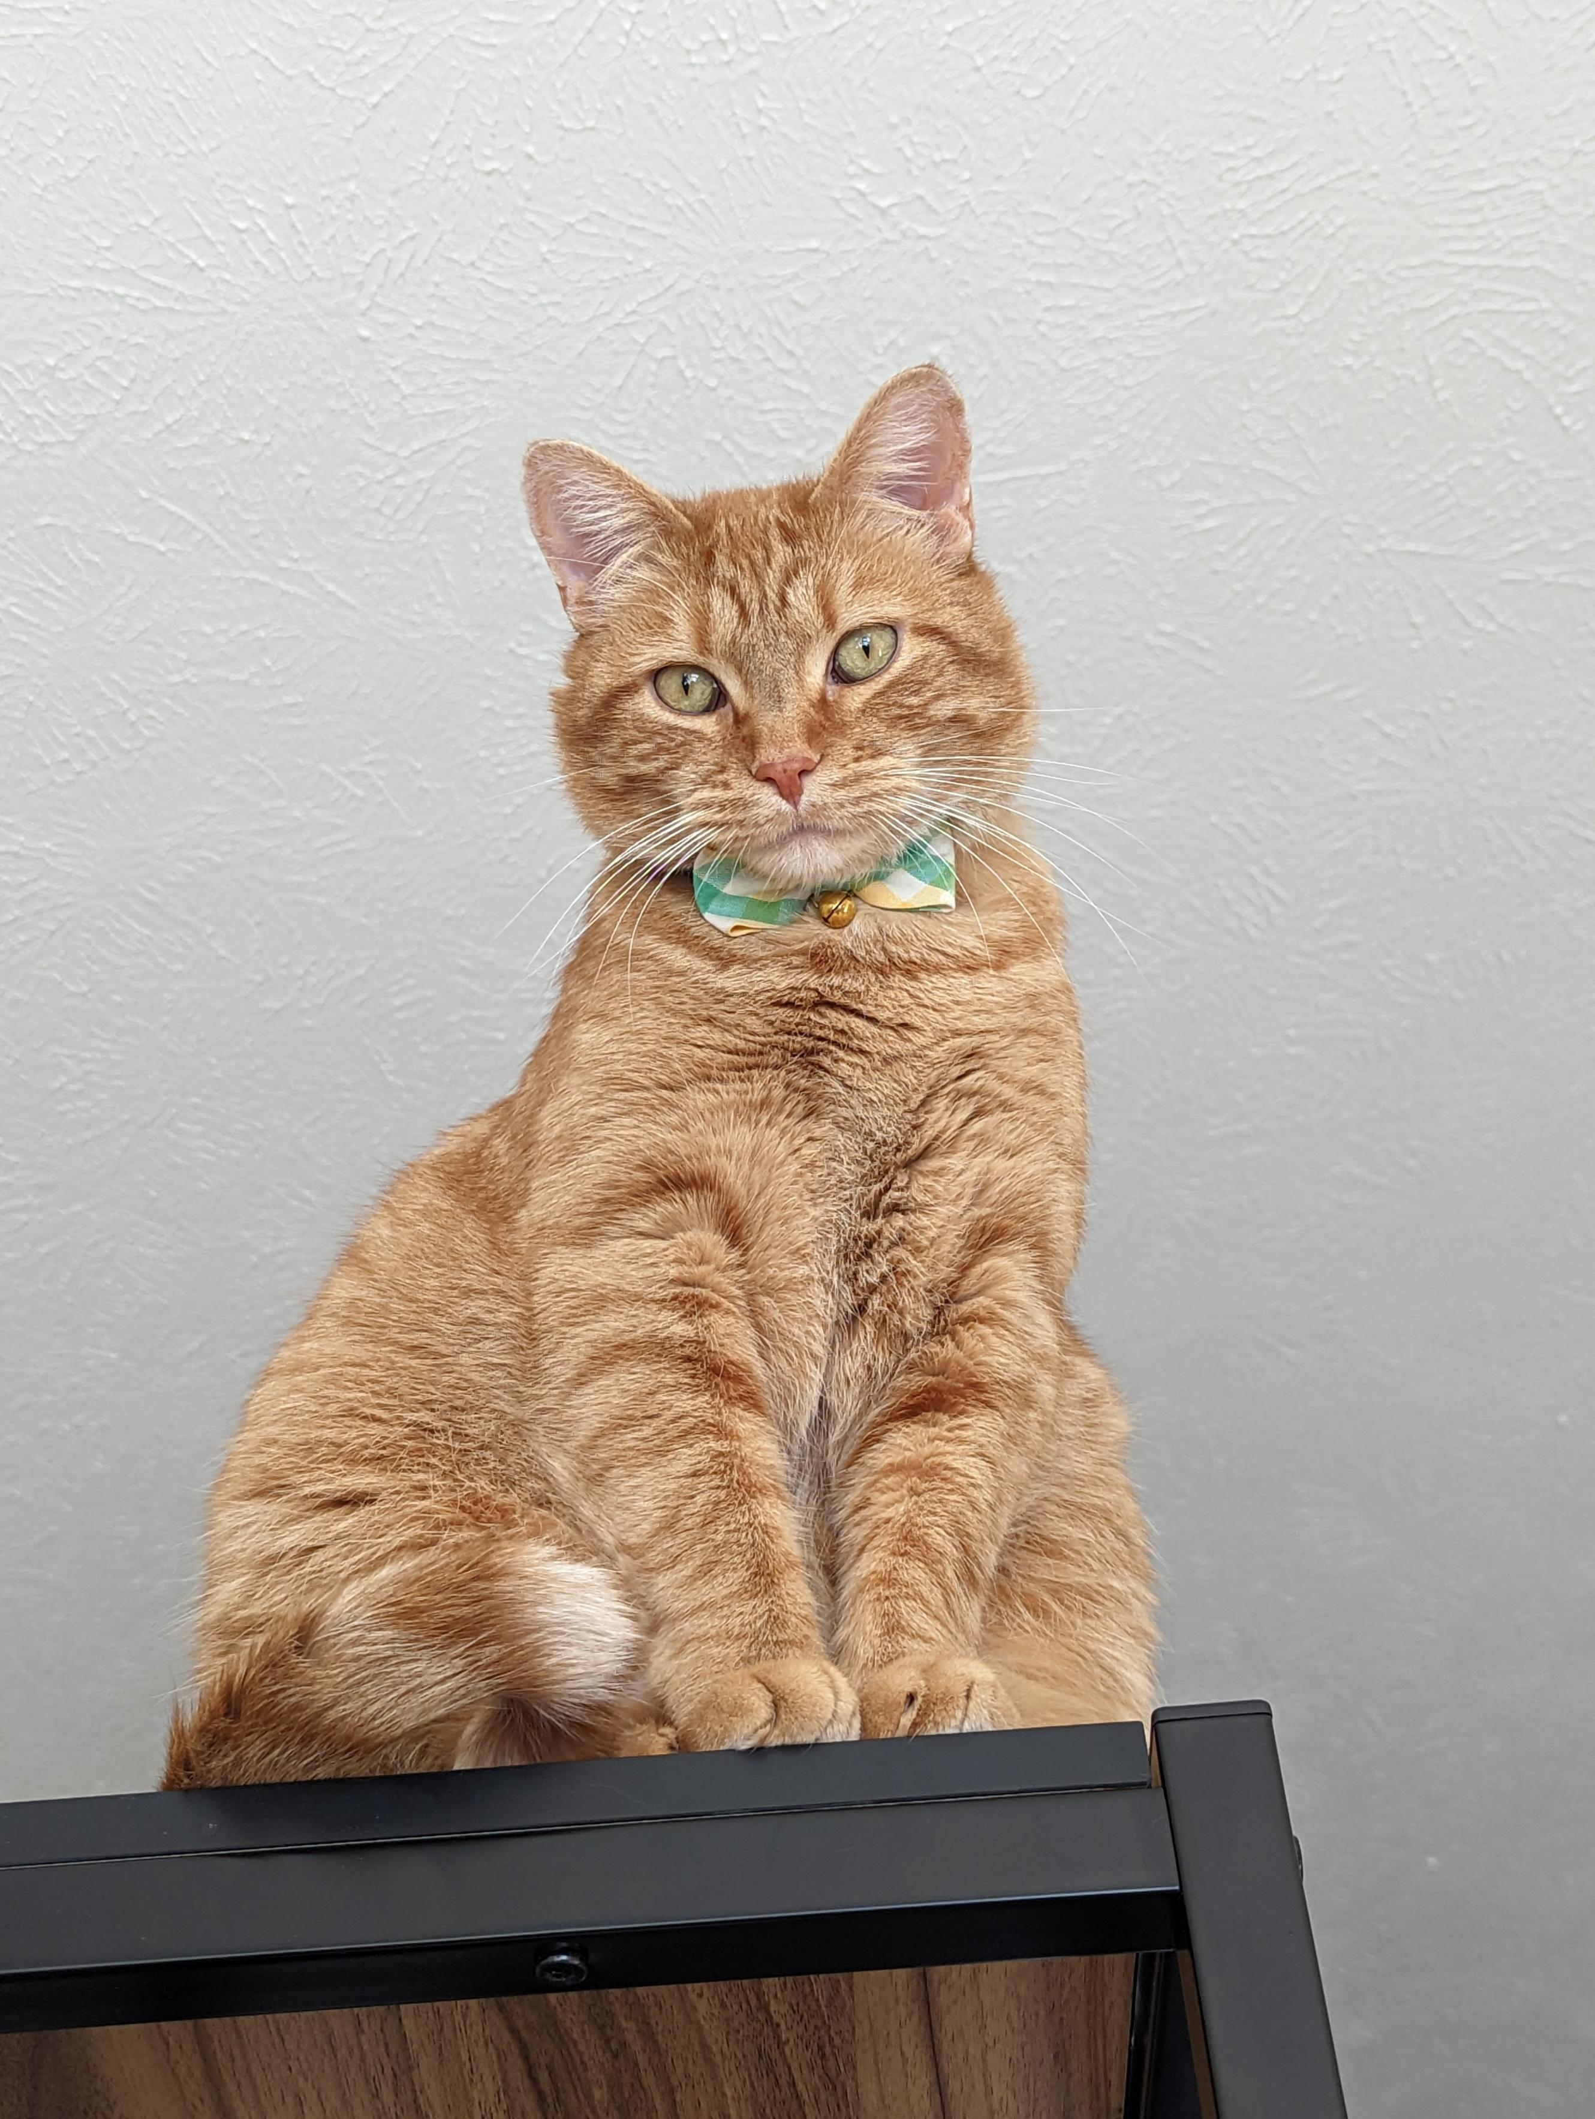
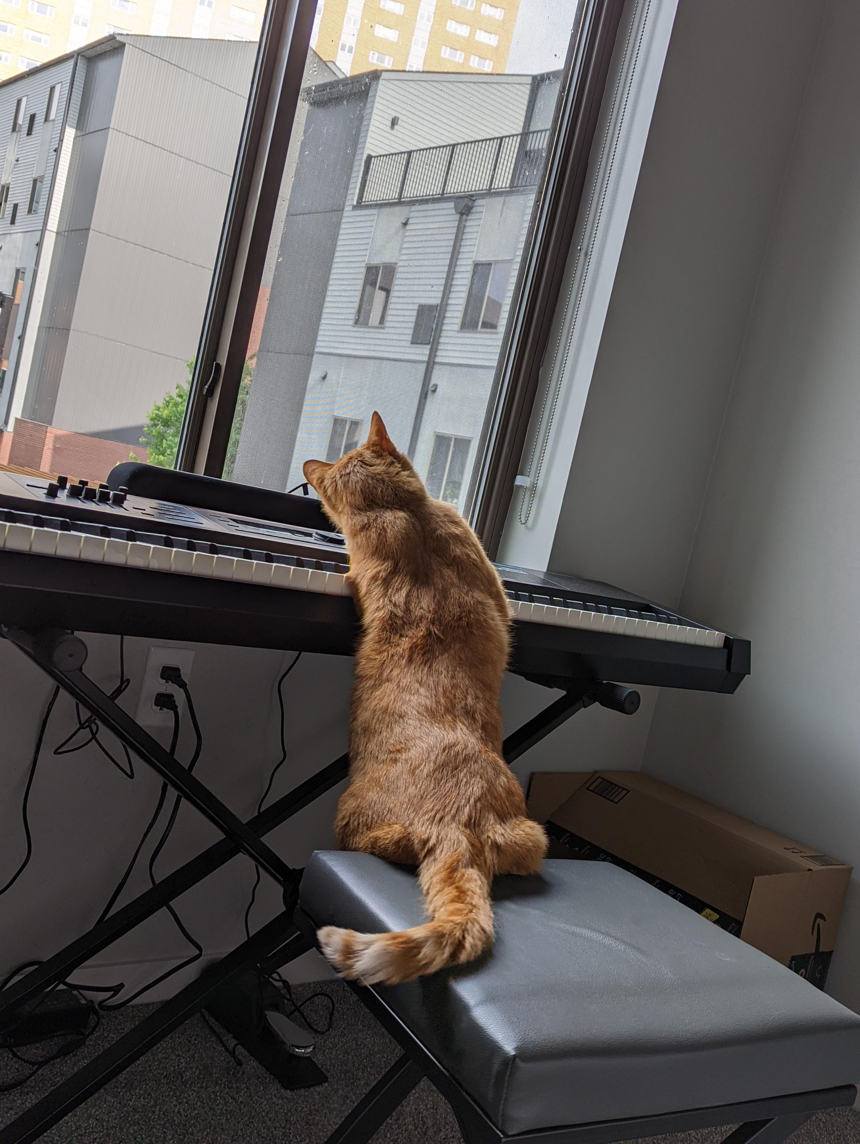
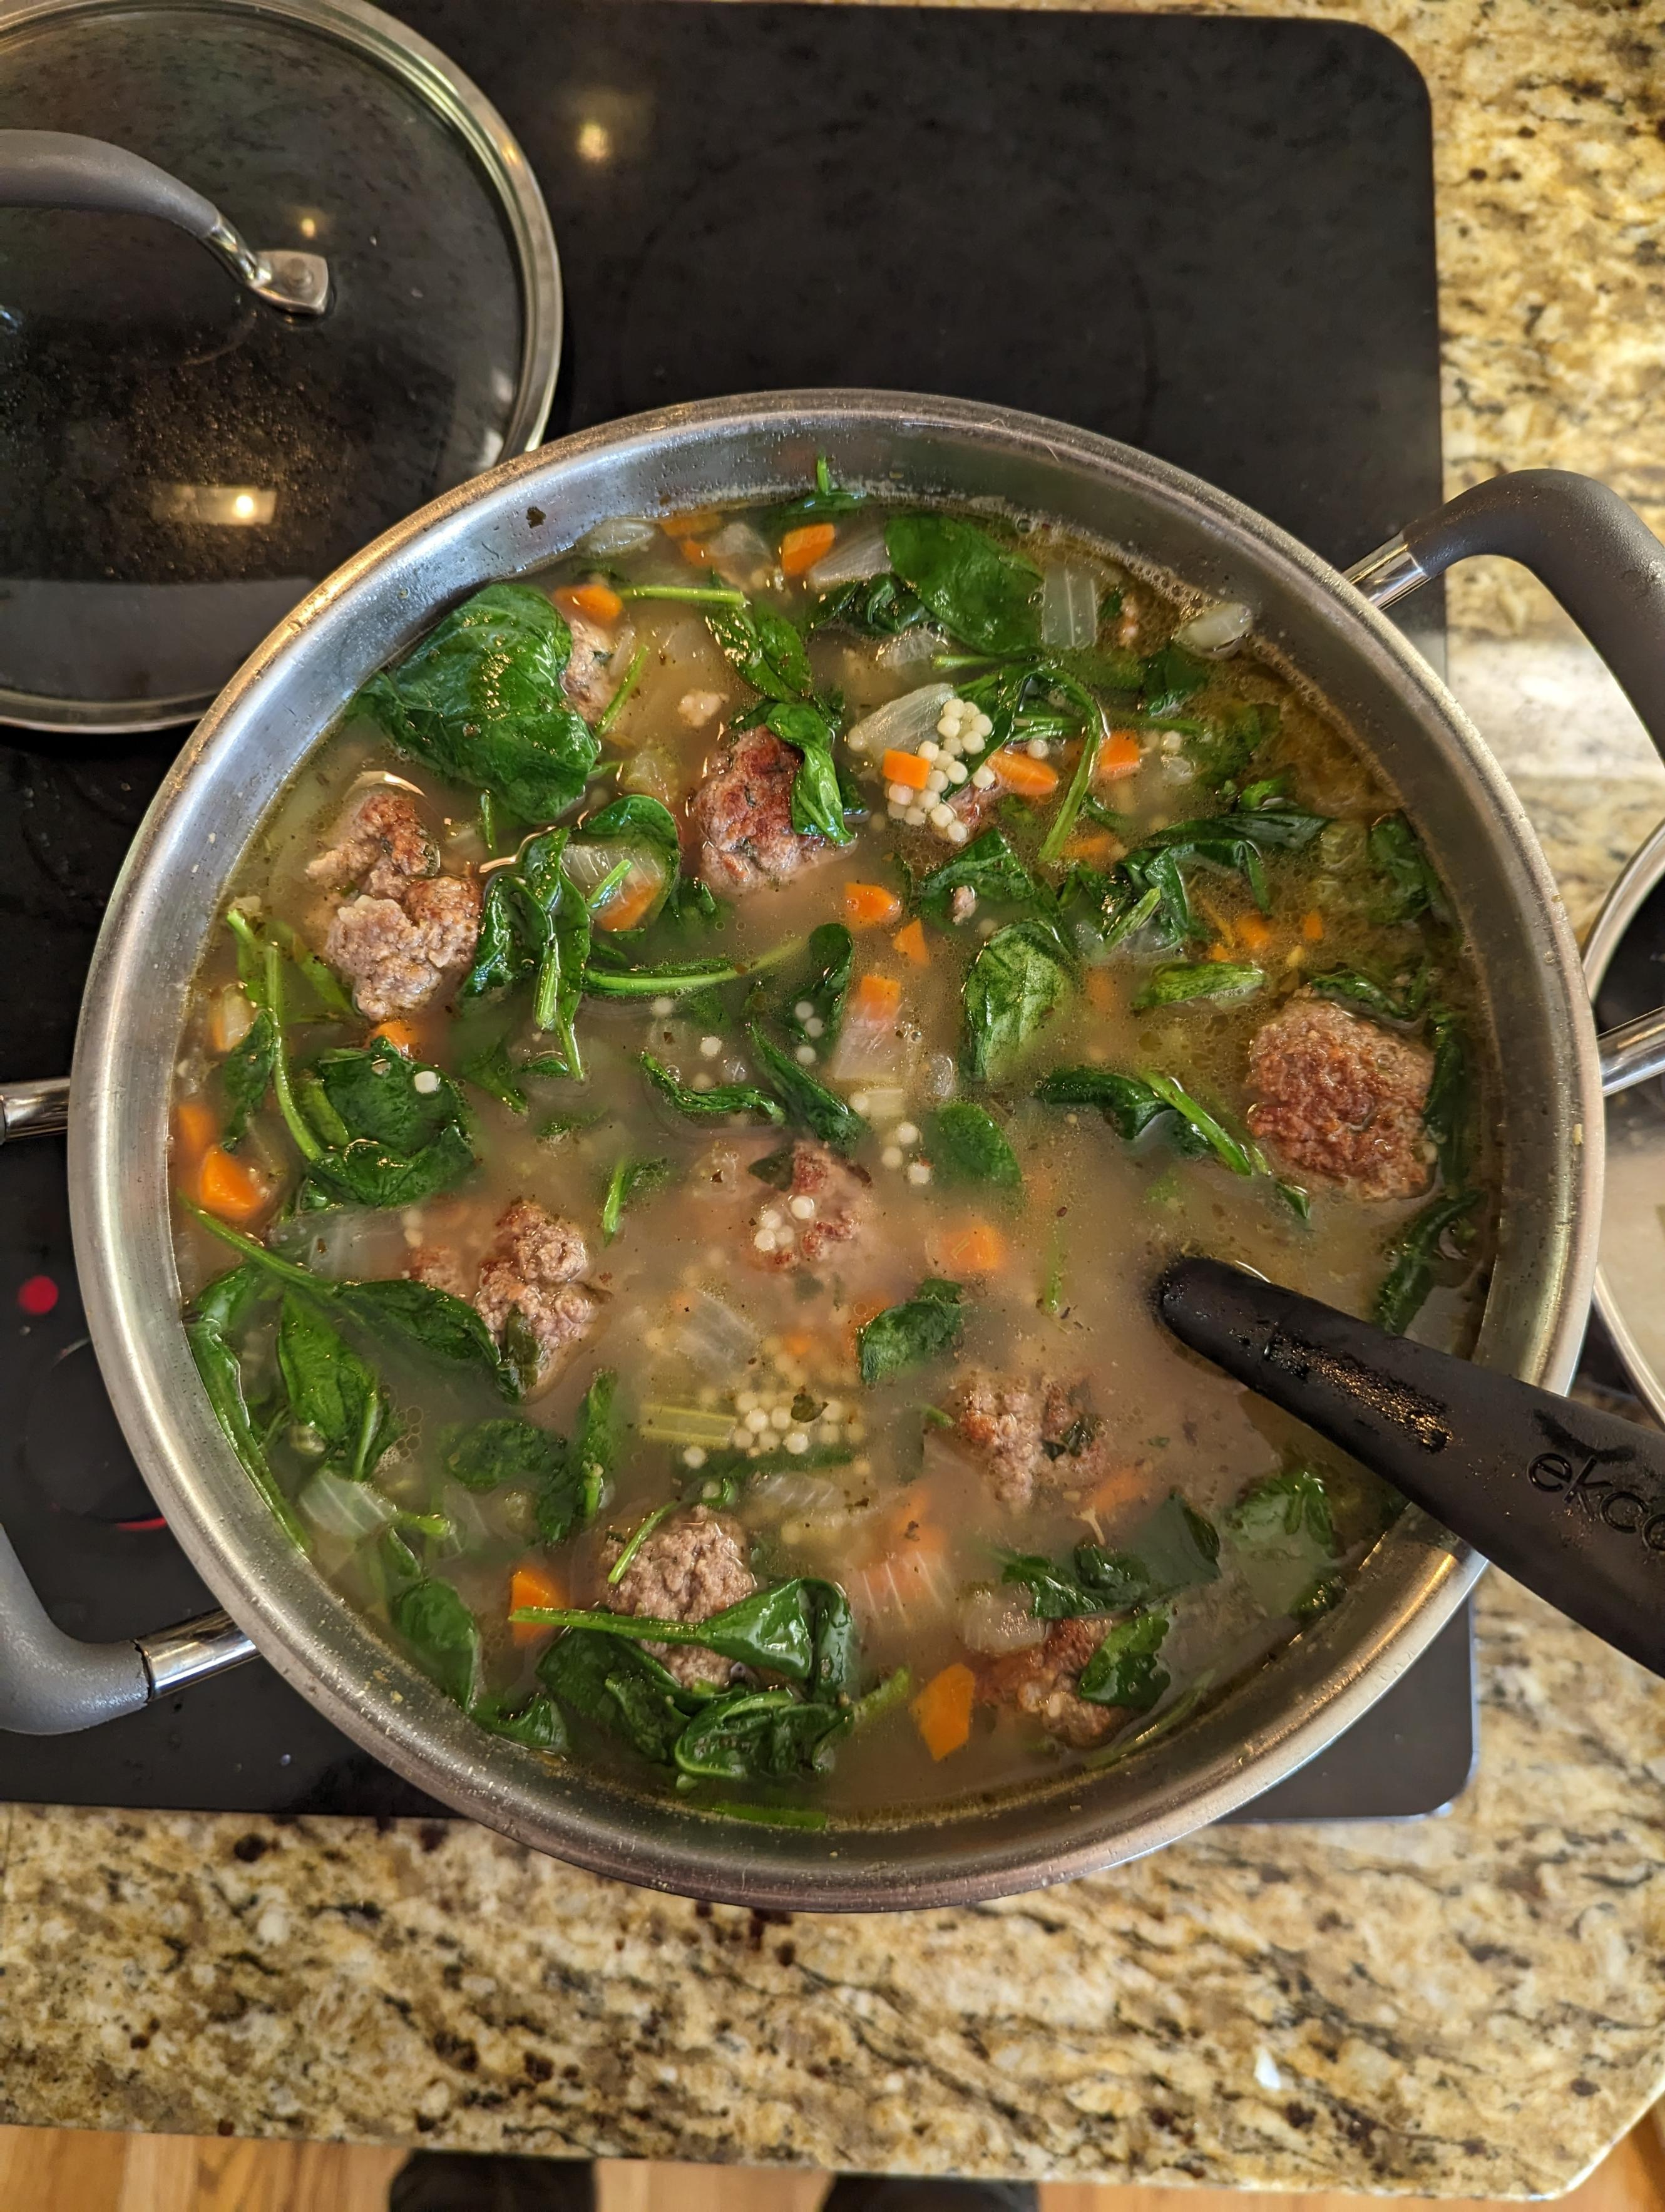


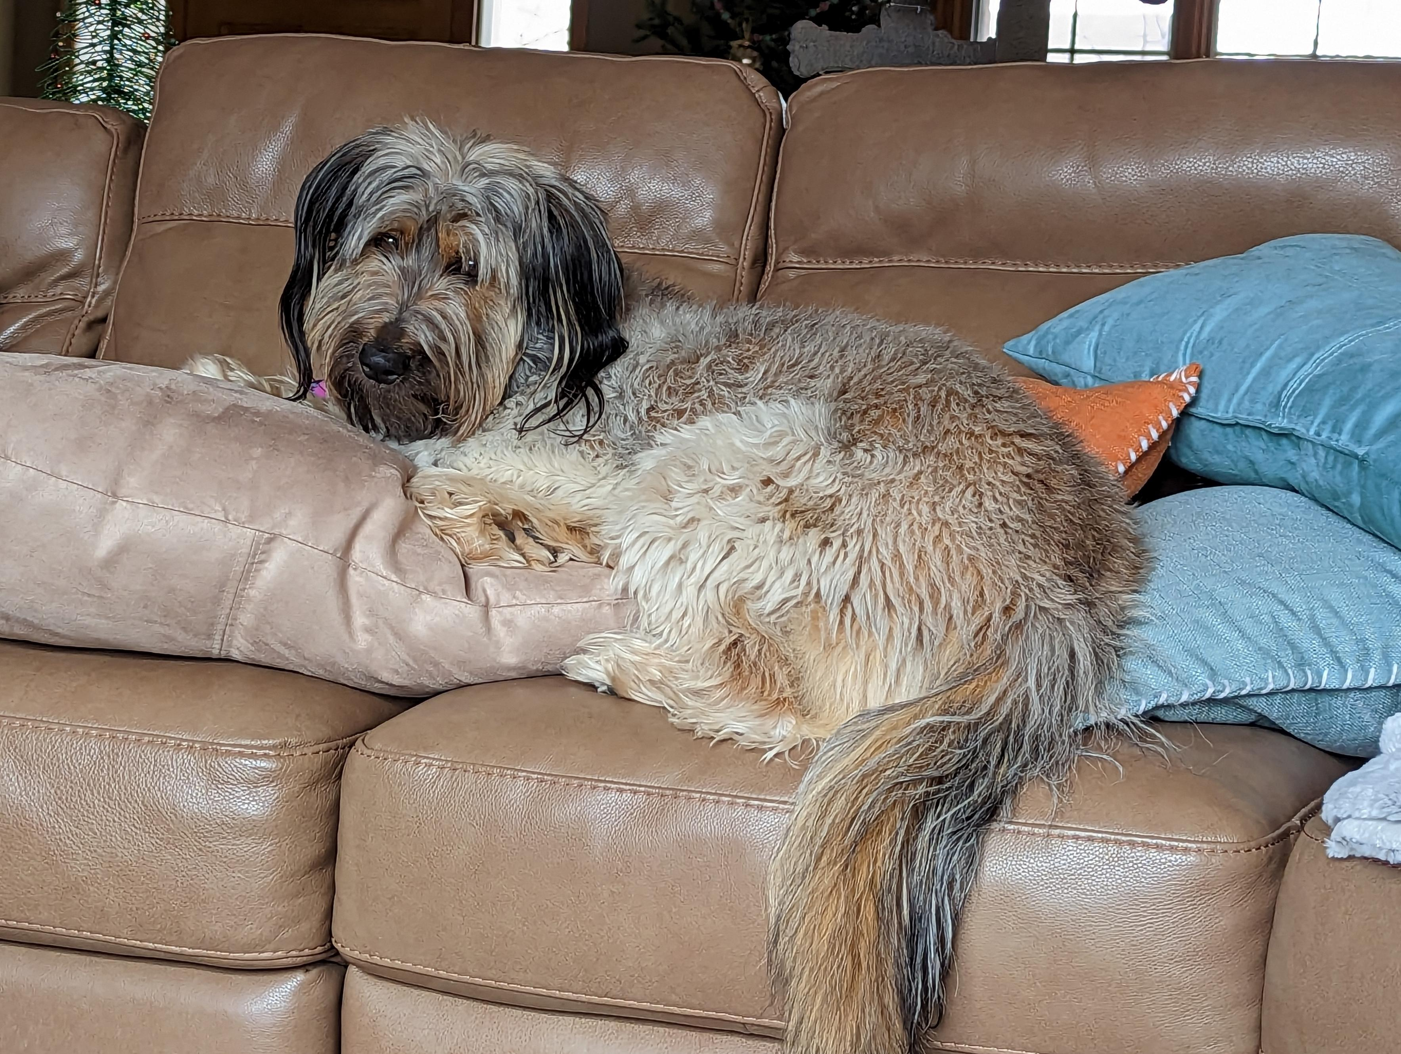

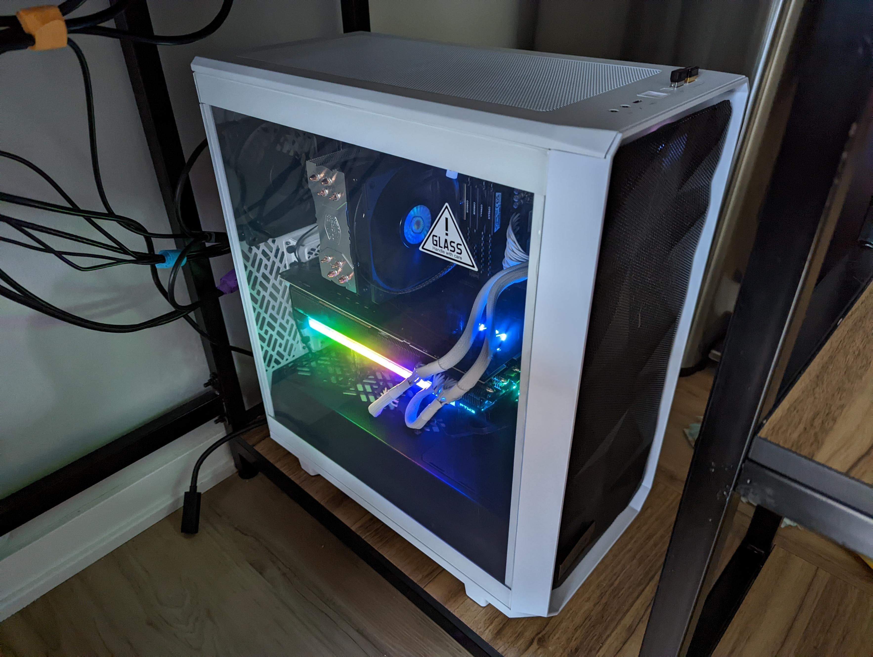
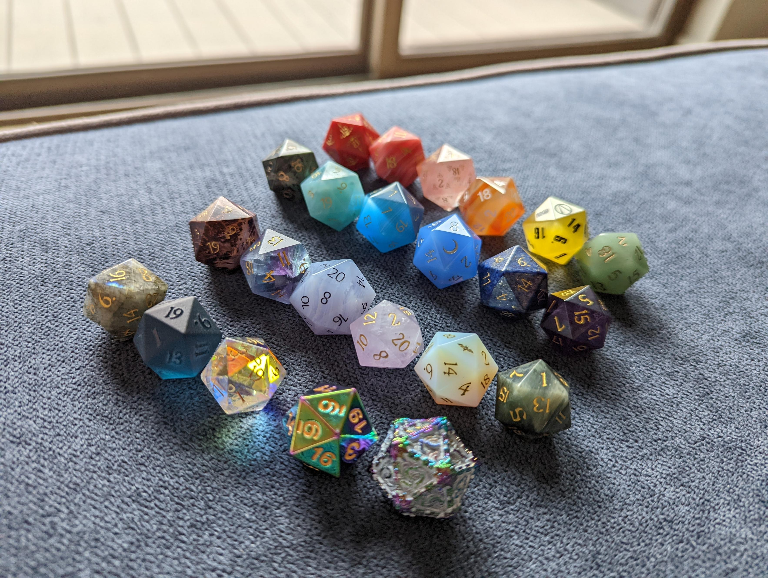


Harper Price F.O.R.M.
Family
Family of four; my mom is from Des Moines, and my dad is from Norfolk.
My sister and I were both born in Omaha; I still live here, and my sister lives in Salt Lake City.
I have one cat named Giovanni, and my sister has a dog named Juniper.
Occupation
Software Development Specialist
Graduated from UNO in May of 2021 with a dual major in computer science and cybersecurity.
Started at TD Ameritrade as an intern; I continued after college as a full-time employee and have been working here for almost 4 years.
Recreation
I am an avid pianist and have been playing since I was 7. I enjoy playing jazz improv in my free time.
I've been hooked on D&D since my college roommates introduced me to it.
I'm a soup connouisseuse and enjoy finding new soup recipes to cook and refine.
I enjoy tinkering with computers, both in software and in hardware.
Motivation
I enjoy solving problems, optimizing solutions, automation, and improving ease of use.
I'm motivated to be able to treat myself and those close to me well.
I am prone to making bad puns and nerdy jokes.
As someone who is bisexual and transgender, LGBTQ+ activism matters greatly to me.

Slide 4
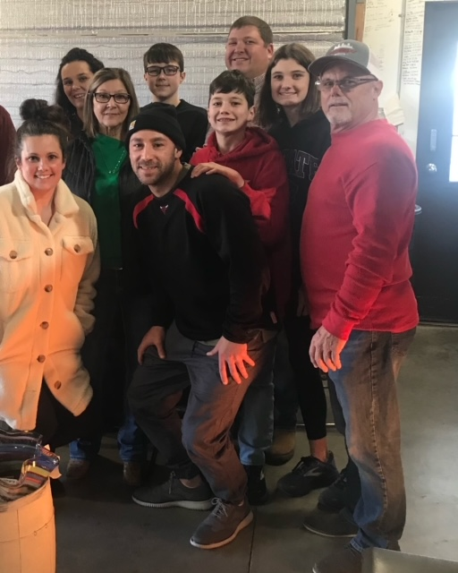

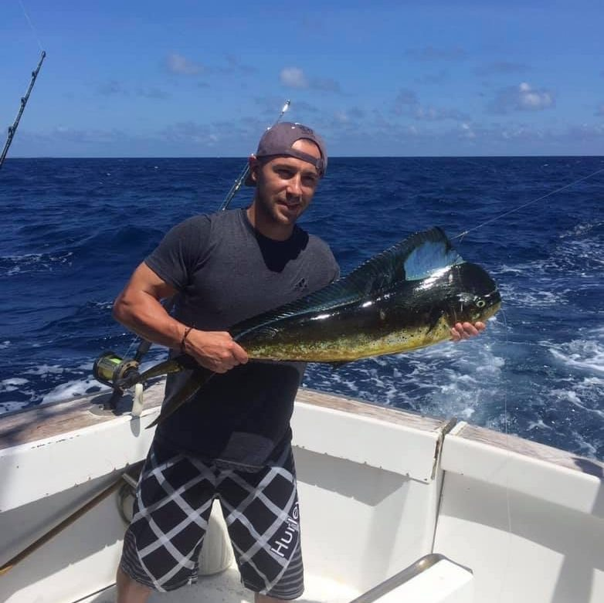
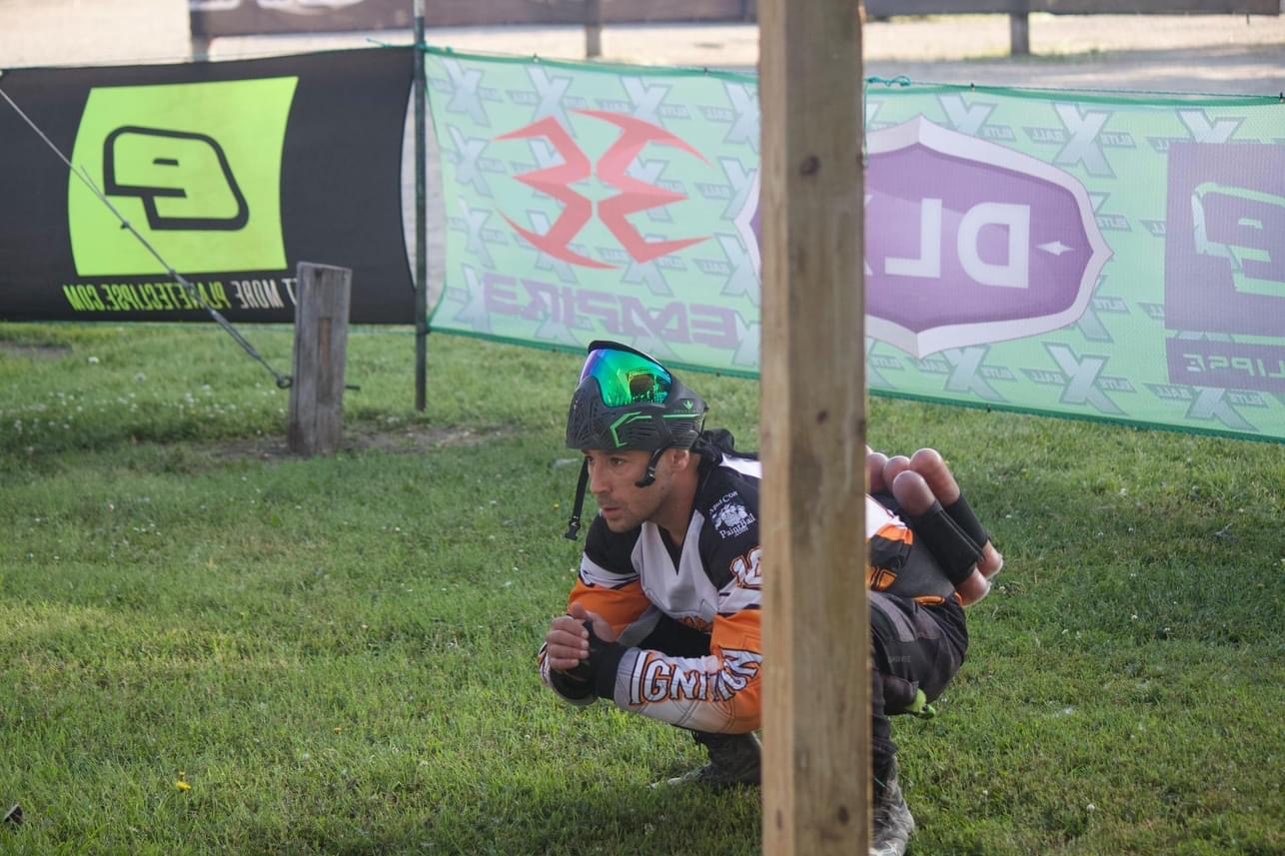





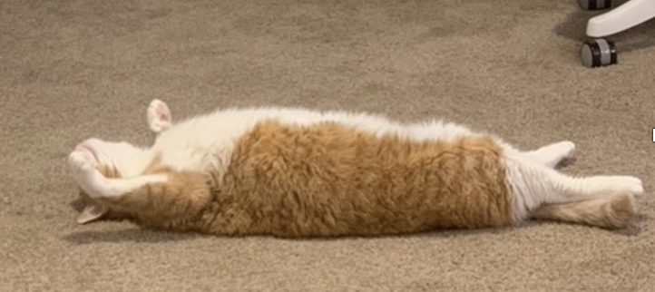
Matt Motter F.O.R.M.
Family
Not married, no kids.
Only Child
One cat – Leland
Grew up in the Omaha area, but most of my family members are spread across KS, ND, NM, and NC.
Occupation
Organizations I’ve spent time in include BOS, CDMT, and NGOMS
Passionate about building Java REST Services. As well as providing value in anyway I can.
B.S. in Computer Engineer from The University of Nebraska at Lincoln.
Recreation
You can find me in the gym lifting weights after work. It has turned into my main hobby recently.
Spend most of my free time on the weekends with friends or visiting family, helping others, and small DIY projects and fishing.
Love watching college basketball – Huskers/Creighton
Fun Fact: Played D4/D5 amateur paintball for 2 seasons
Motivation
Passionate about helping others.
I’m easy going, not too much bothers me. I prefer to roll with the punches and control what I can control and not worry about what I can’t control.

Slide 5
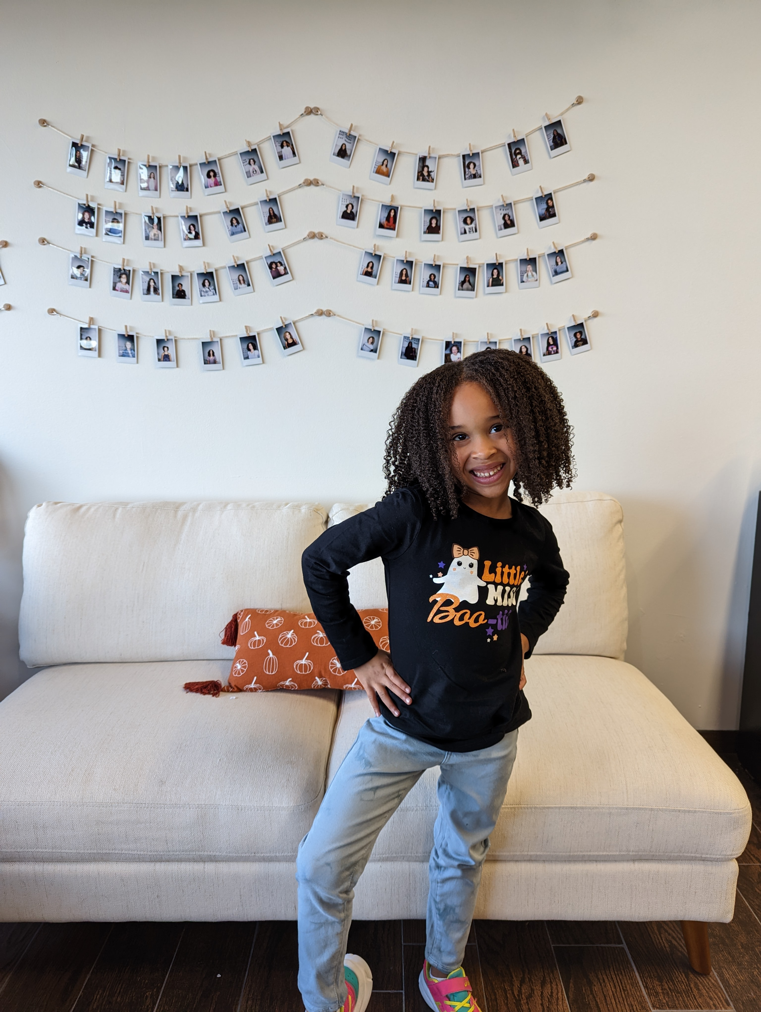

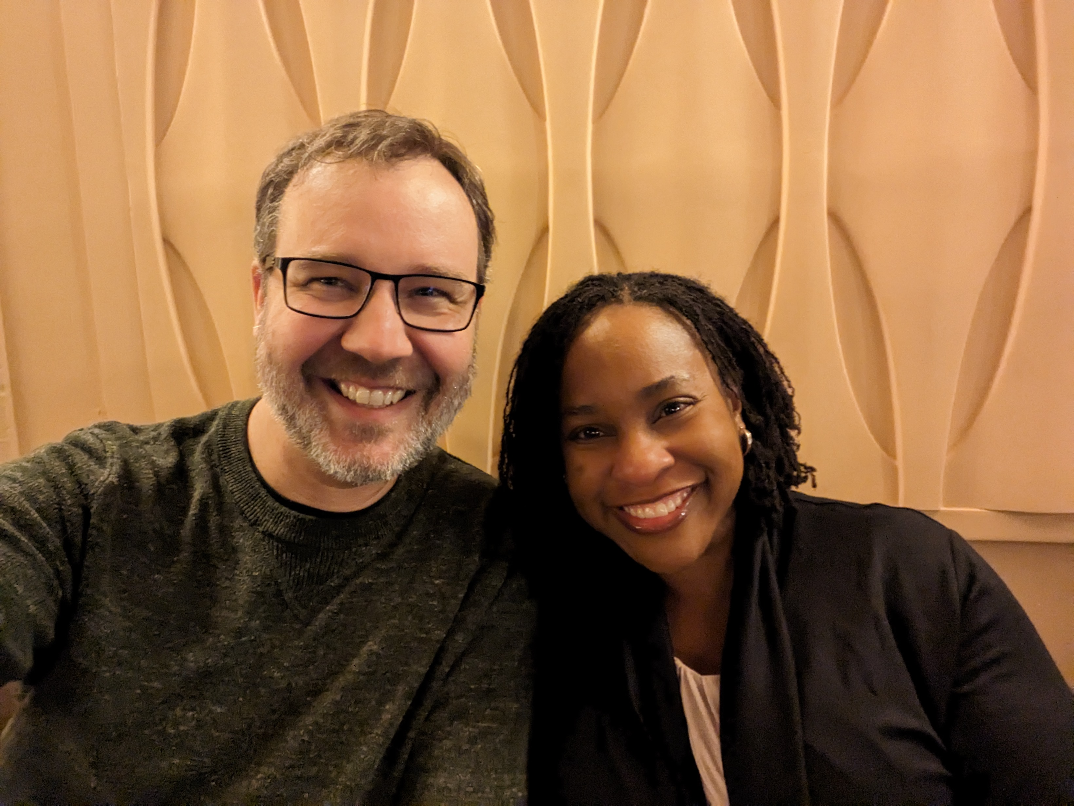
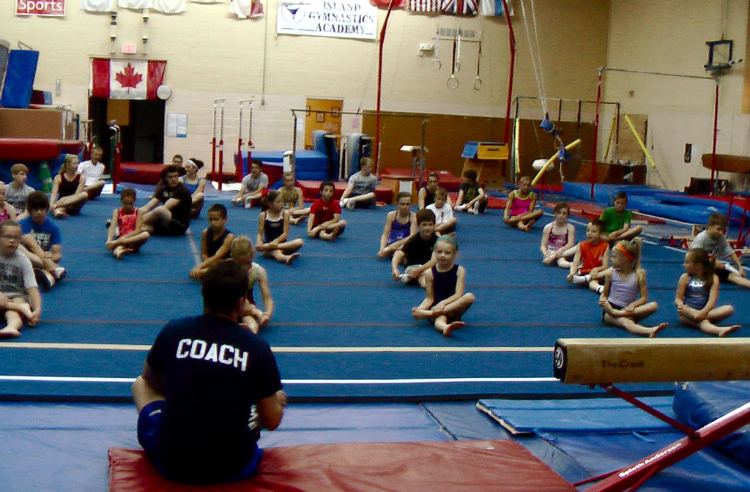


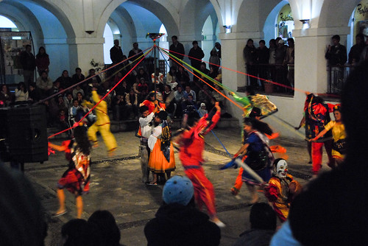
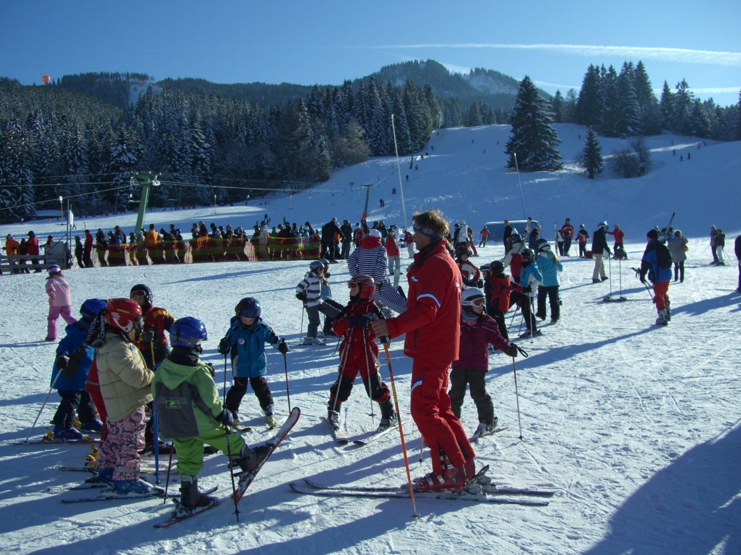


Ron Horner F.O.R.M.
Family
Married on Sept 1, 2013 in Puerto Aventuras in Mexico.
1 child Vivian (6)
My parents and mother in law live in the Omaha area along with my brother. The rest of my 4 siblings are in MI, WA, IA, and DC.
Occupation
Process Optimizer and Software Engineer
I love writing software; I've been a manager, security auditor, scrum master, agile coach, continuous improvement specialist, and blue team hacker.
B.S. and M.S. in Computer Science from University of Nebraska Omaha.
Recreation
Full time girl dad – gymnastics, swim, dance.
Theater, Broadway, Live Concerts
Cooking – I've gotten at least a dozen new cookbooks in the past year
Traveling, ocean cruises, skiing, hiking.
Teach Business Information Technology and Management at UNO
Married into a Raiders family
Motivation
I like to stay busy with a lot of different projects; I do not like to sit idle.
Happiness is a choice and 99.999% of the time I choose to be happy
Try to be as amazing as my wife.
Working towards an end goal or purpose

Slide 6
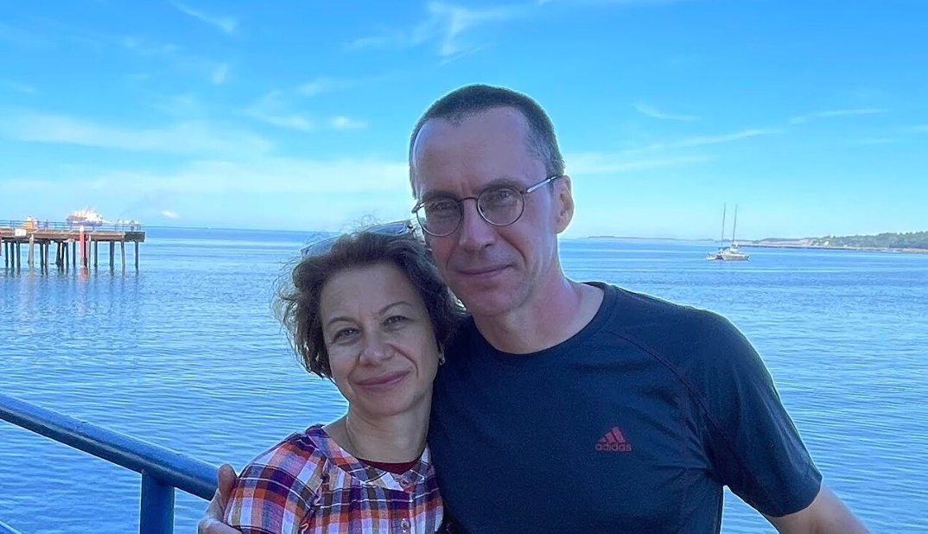
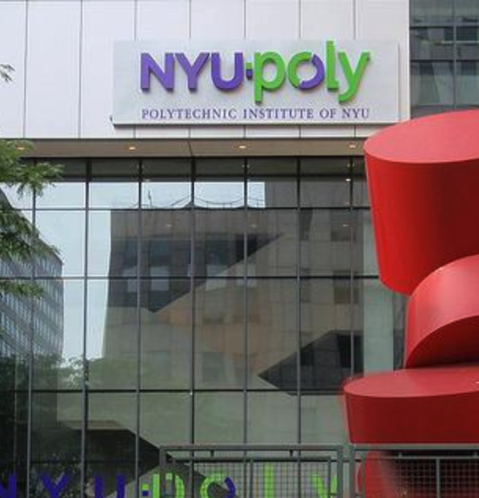
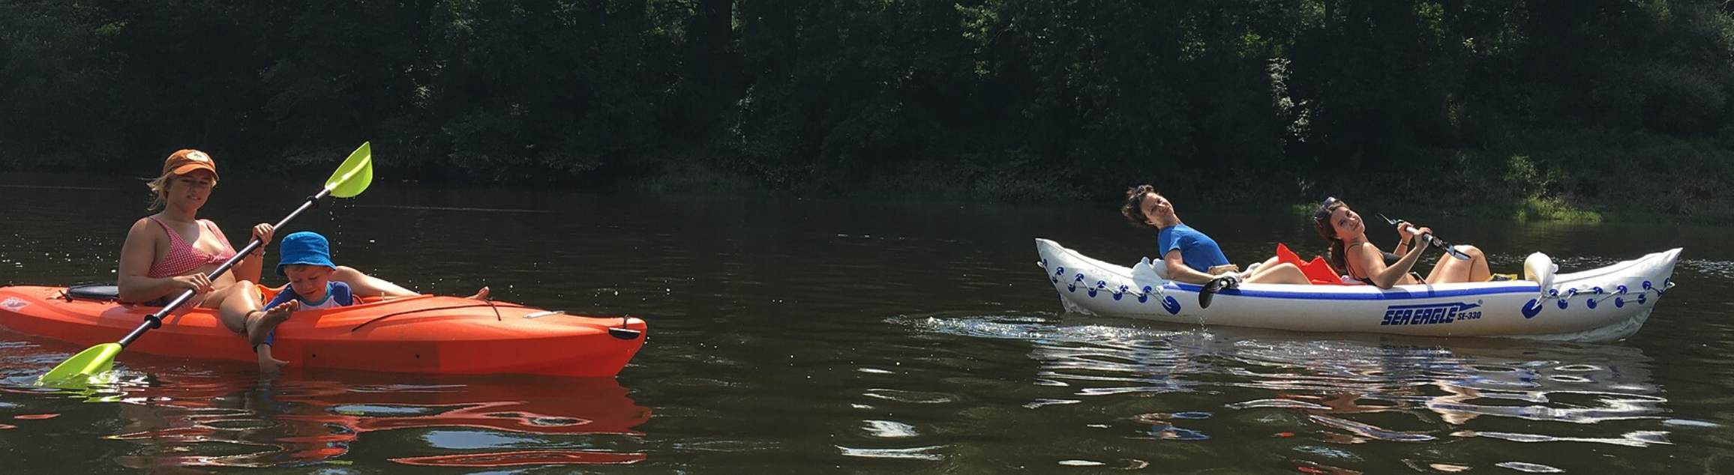
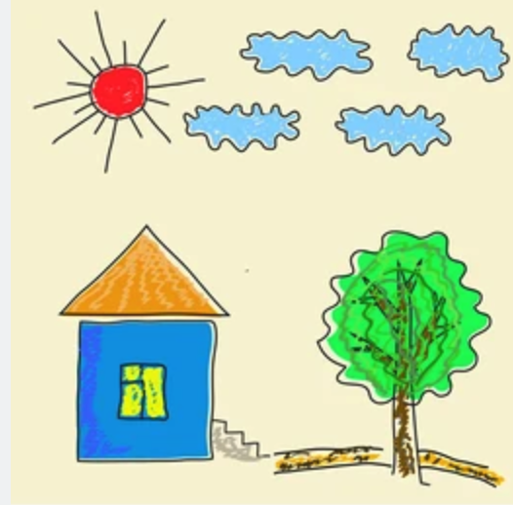
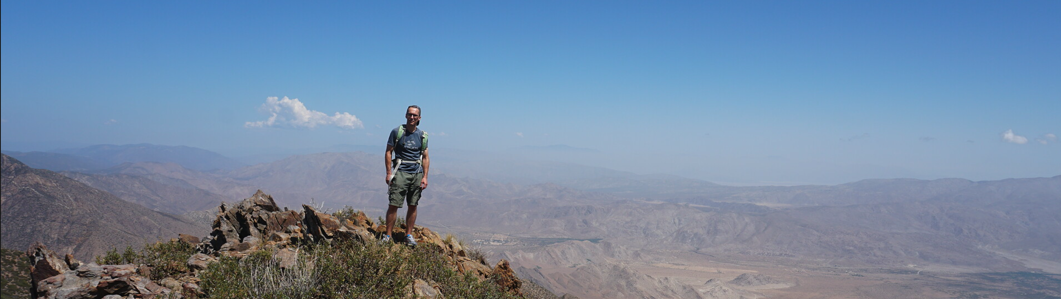

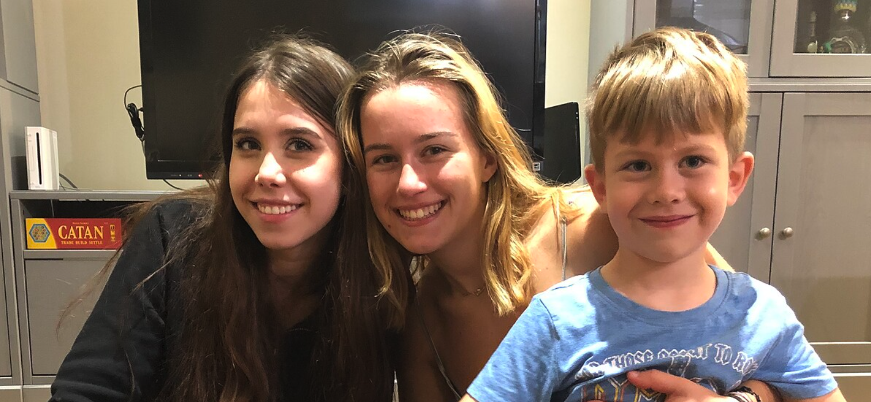



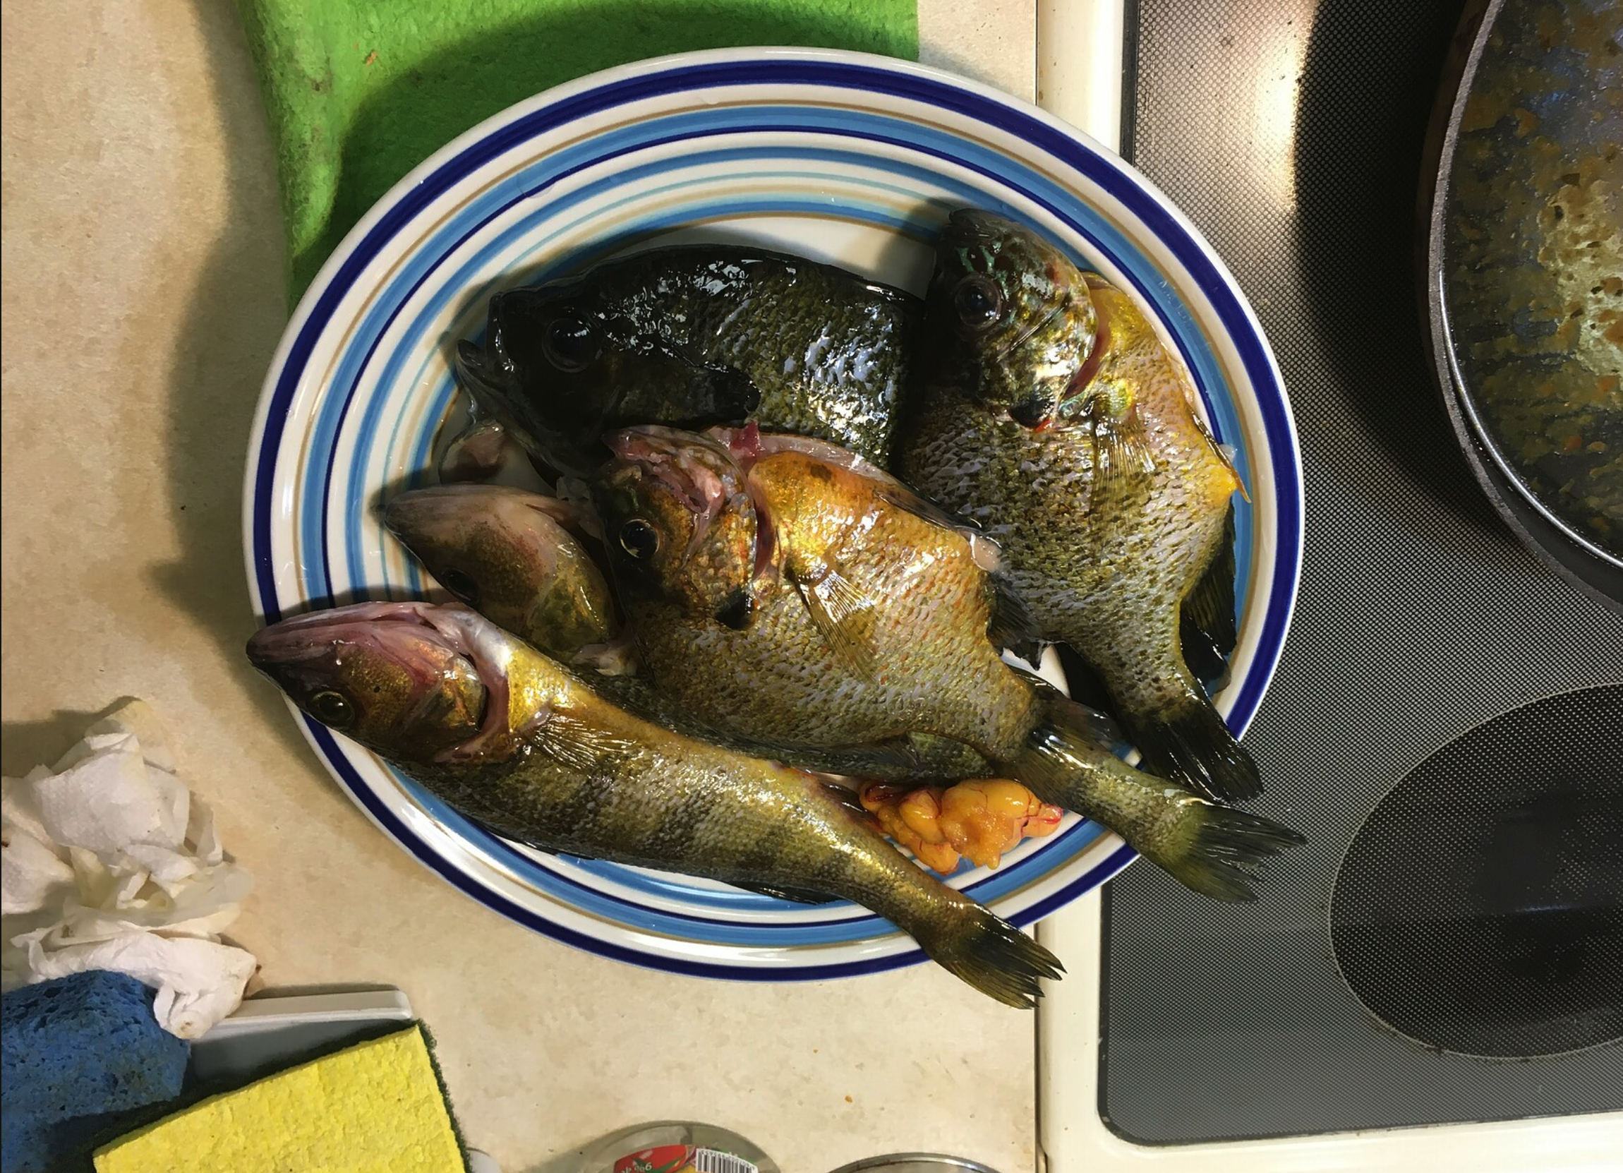
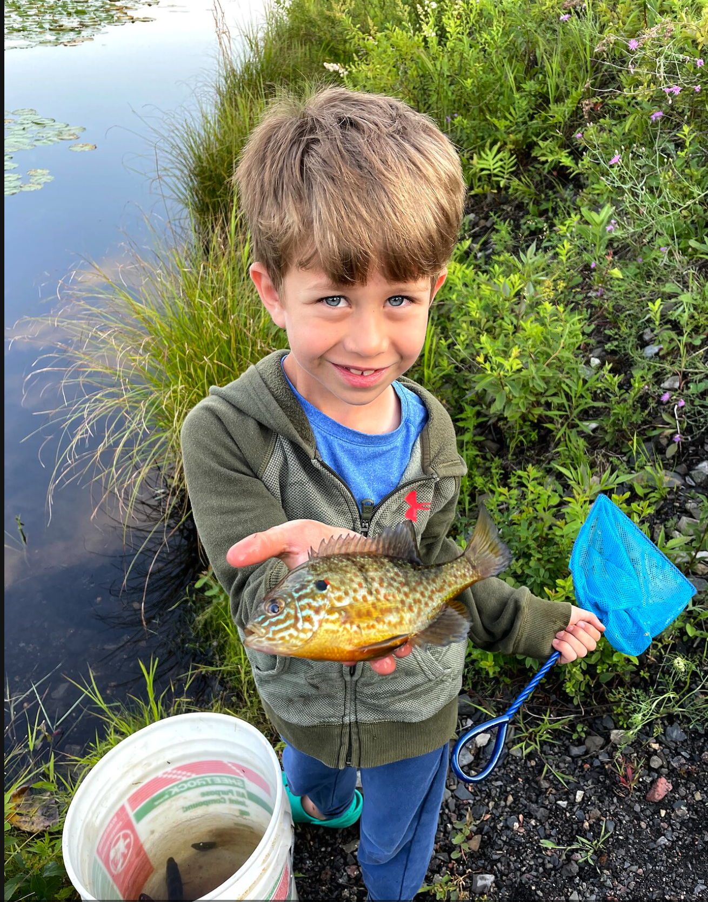



Aleksey Pokalyukhin F.O.R.M.
Family
Married Anna somewhere before 2000 in Russia, Kazan.
3 kids: Lucy (19), Katrin (23), and Evan (8).
My parents still in Russia. My siter with her husband and 2 kids here in NY.
Numerous relatives of my wife live in NY, NJ, CA, FL, IL and in some other states and countries.
Occupation
Software Developer
M.S. in Computer Science from NYU Polytechnic School of Engineering.
B.S. in Electrical Engineering from Power Engineering University, Moscow, Russia.
Fun fact: I joined TDA shortly before announcement of acquisition by Charles Schwab.
Recreation
Used to be full time dad for my girls – gymnastics, dance, piano, arts. Now same for son – soccer, chess, piano, ninja worriers.
Like to spend time in nature, hiking, boating, camping, fishing.
Like to do any work by hands, creating furniture, home restoration, remodeling, any other work.
I enjoy running and participating races.
Motivation
I like to explore new things, any kind of positive creativity inspires me.
Financial freedom and my family stability is important to me.
The family is my motivation, my wife is very positive and social person in contrast to me, she is my driver.

Slide 7
What is F.O.R.M.?
F.O.R.M. is an acronym that stands for Family, Occupation, Recreation and Motivation. We can use the F.O.R.M. exercise to learn more about one another and what is important in our lives. When you find out what motivates someone, you can build better connections and understandings of one another.
F – Family: Share a little about your family! Do you have siblings? A partner? Kids? Pets? Where does your family reside?
O – Occupation: Tell us about your role and how you got there! Where did you attend school? Any passions that fuel your work?
R – Recreation: What do you do in your spare time? Are you a fan of the great outdoors? Is your nose always in a book? Tell us what keeps you busy!
M – Motivation: What drives you to be the best you can be? Aside from work and recreation, what is really important to you?
Please be sure to DOWNLOAD this template – do not edit in Teams!

